Slide 1
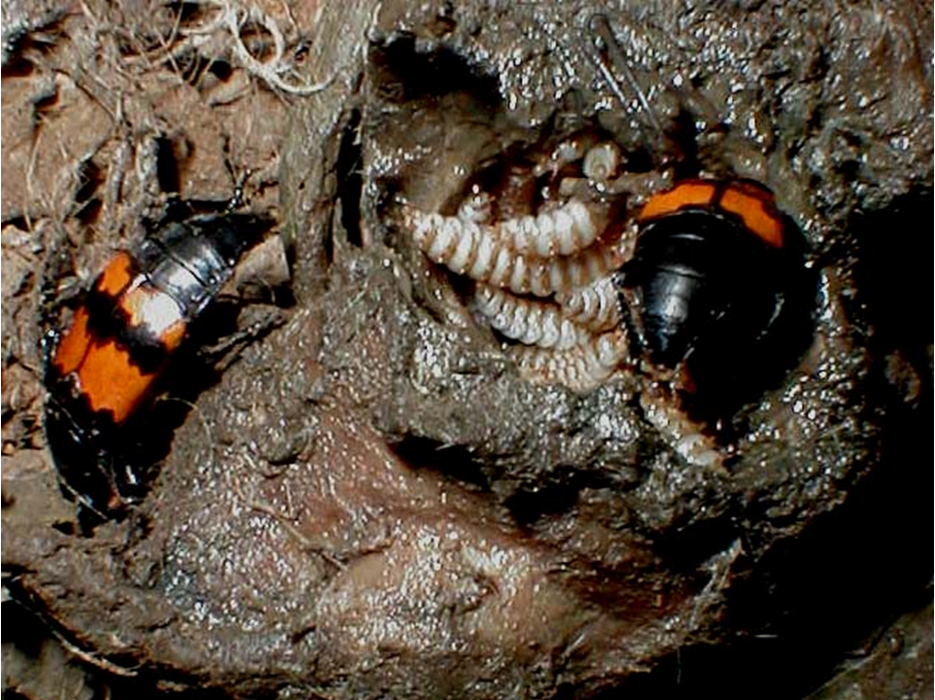
Parental care

Slide 2
Strategies to ensure the survival of the species
1. The r strategy (r = growth rate)
Many offspring
Little or no parental care
Enough survive
E.g. - barnacles, most insects, most fish, and turtles.

Slide 3
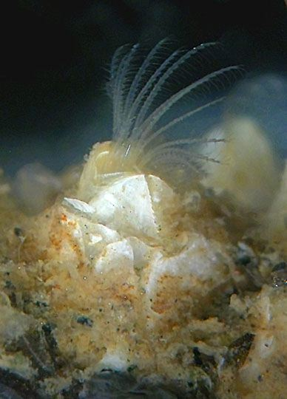
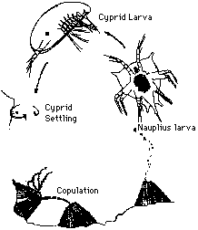
Barnacles are both male and female During the spring and summer, Balanus produces two to six broods. From 1000 to 30,000 larvae are produced in each brood.

Slide 4
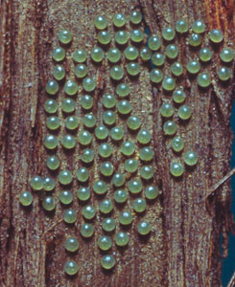
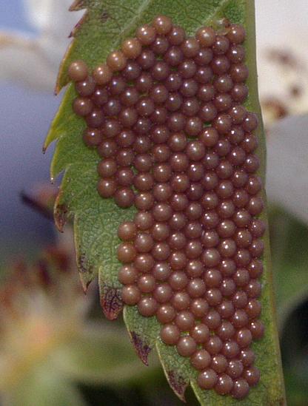
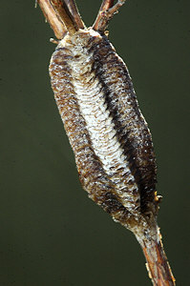
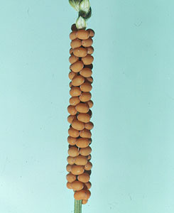
A range of insect eggs

Slide 5
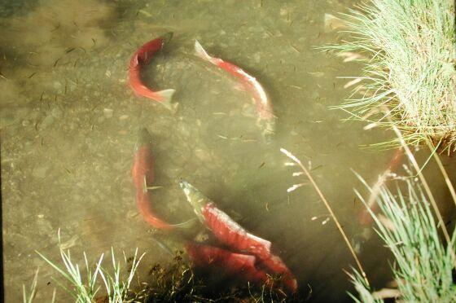
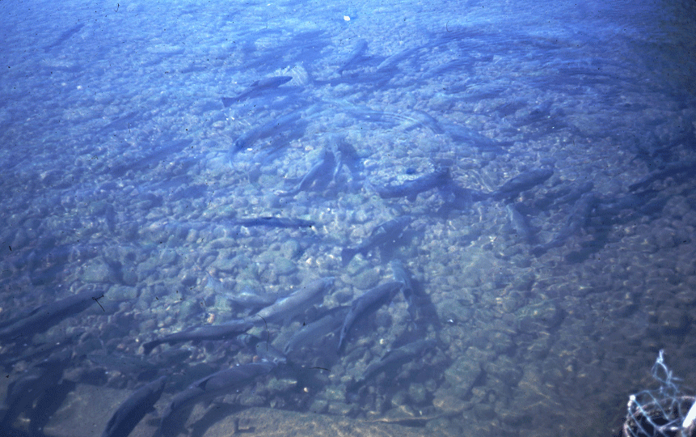
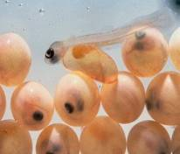
Salmon spawning

Slide 6
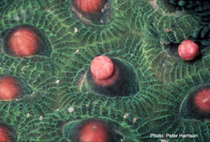
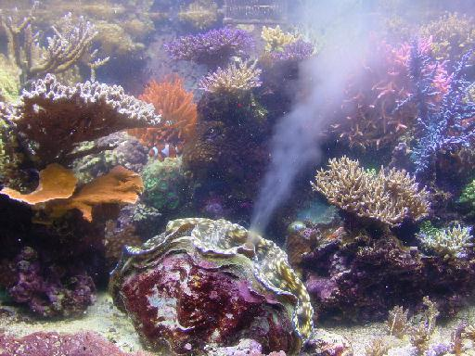
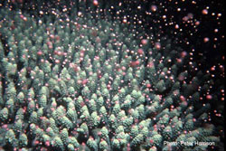
Coral and a clam spawning

Slide 7
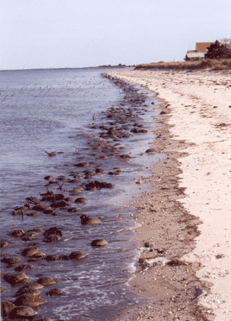
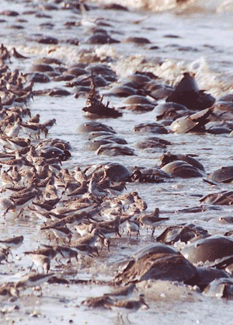
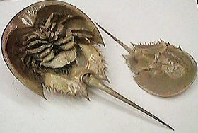
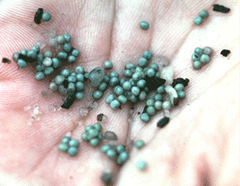
Horseshoe crabs in Delaware

Slide 8
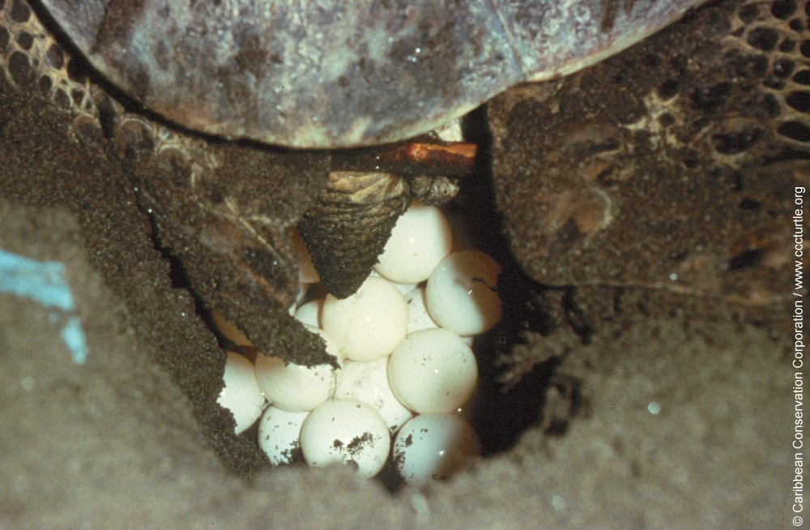
Turtle laying eggs

Slide 9
2. The K strategy (K = carrying capacity)
Usually have stable populations that are close to K
Few, well prepared offspring
Much parental care of eggs and young
High chance of individual survival.
Mammals and birds, only a few insects, reptiles, fish and other animals

Slide 10
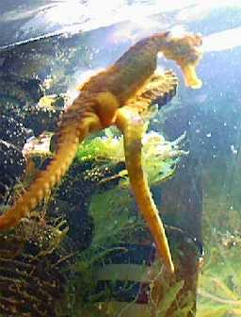
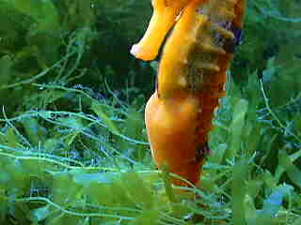
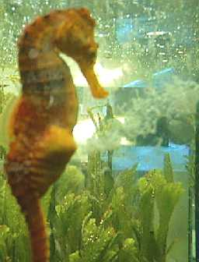
Seahorse breeding

Slide 11
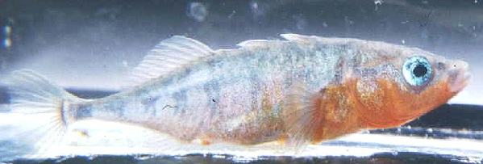
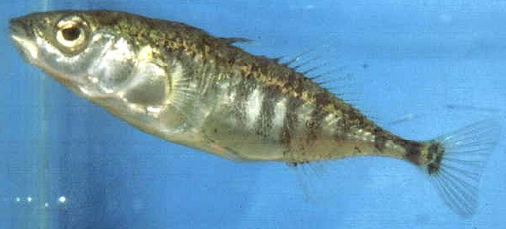
Stickleback
Good dad
  Builds nests, takes care of eggs and young
  Mum
  Leaves dad to do it alone

Slide 12
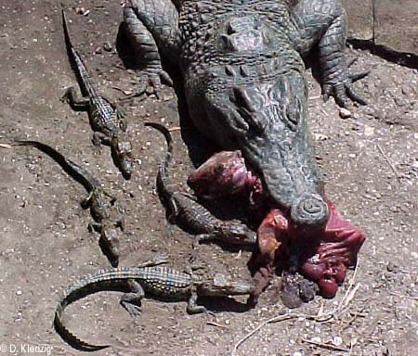
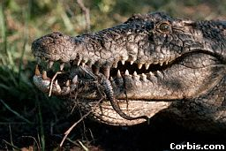
Female crocodiles care for their nest and young

Slide 13
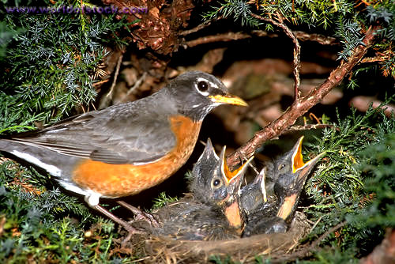
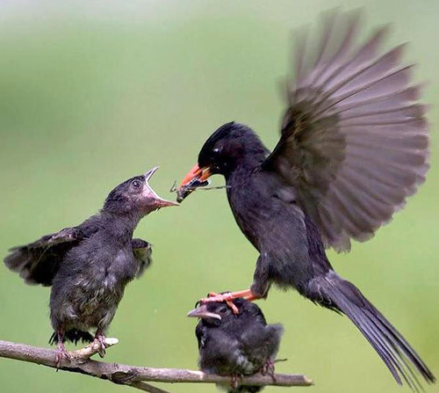

Slide 14
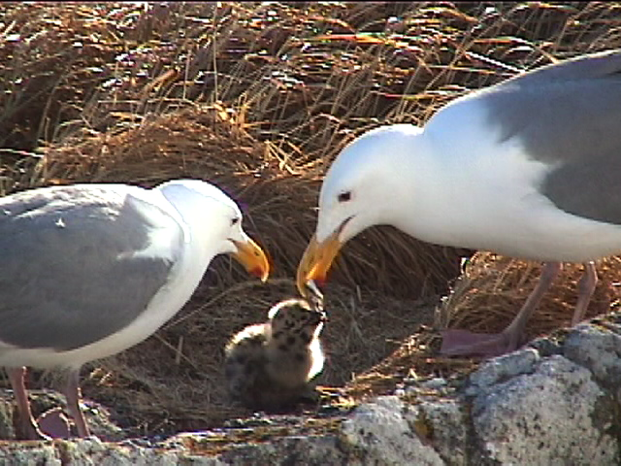

Slide 15
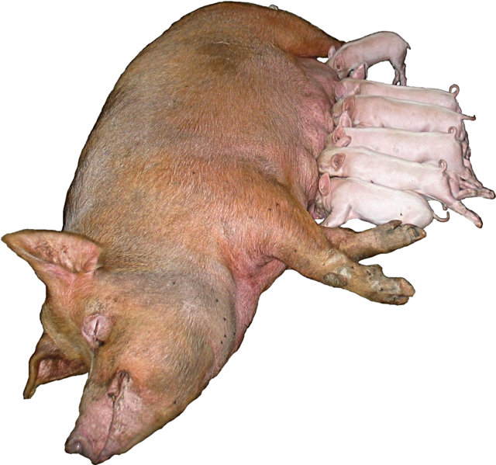

Slide 16


Slide 17
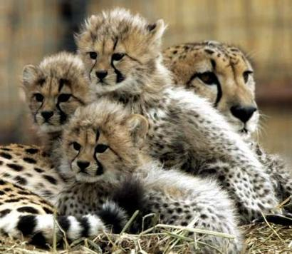

Slide 18
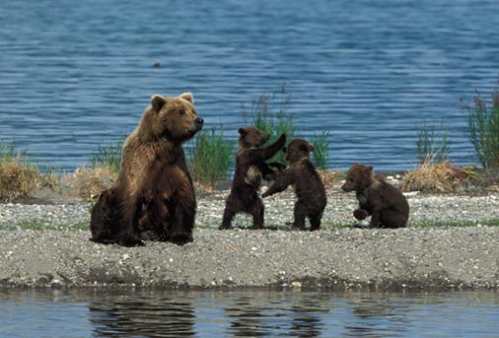
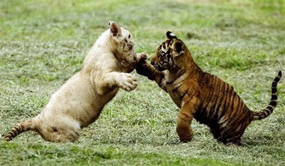
In many mammals, the babies will play at hunting, fighting or fleeing. This prepares them for adult life.

Slide 19
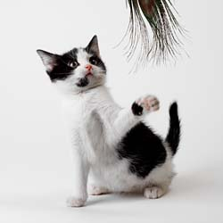
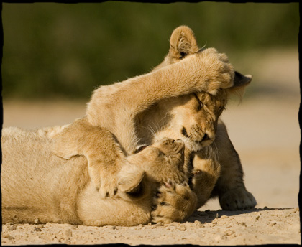
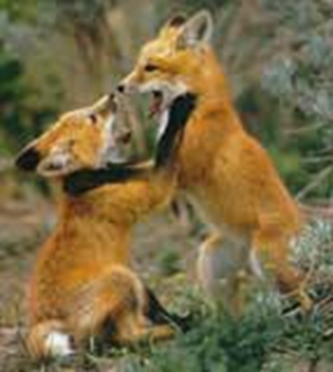
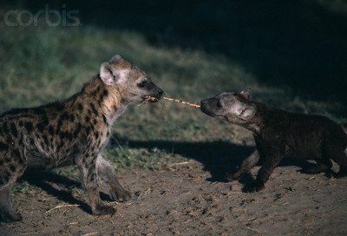

Slide 20
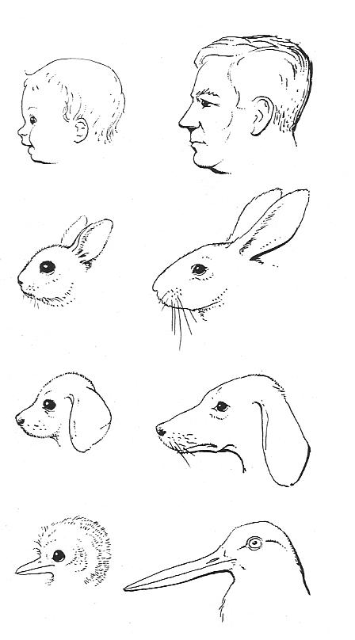
The young often have juvenile features and behaviour patterns which serve to reduce aggressive behaviour in adults: parental care responses are triggered instead of aggression.

Slide 21
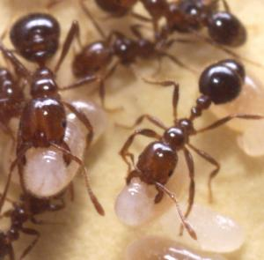
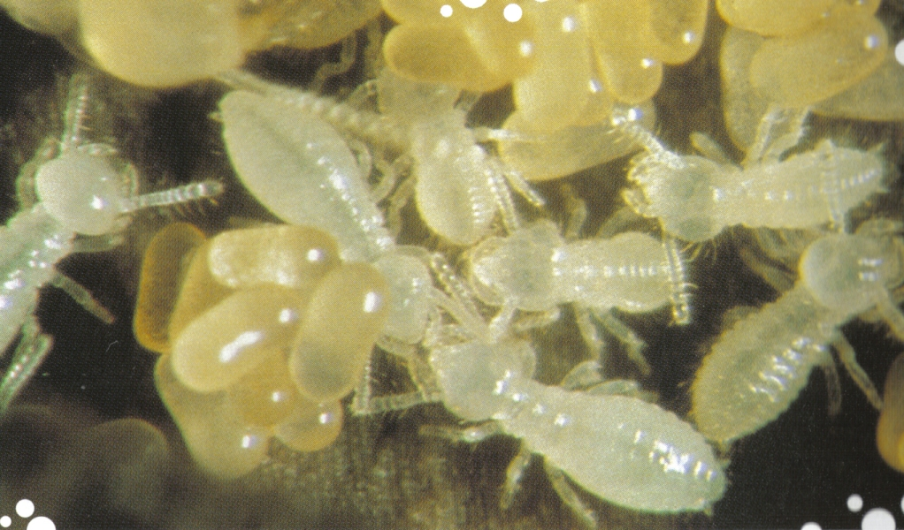
Some insects take care of their young

Slide 22
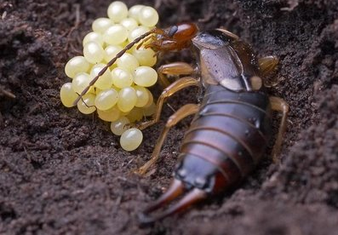
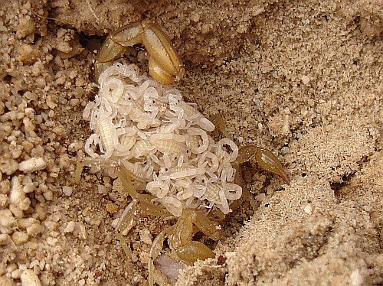
Earwig mum
Scorpion mum
(Arachnid – not an insect)

Slide 23
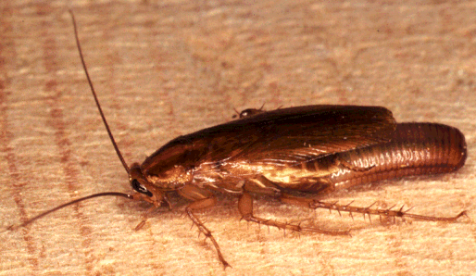
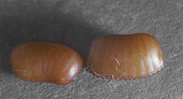
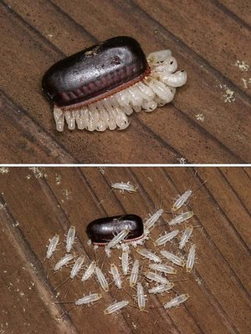
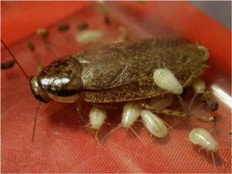
Cockroaches – Yuck!

Slide 24
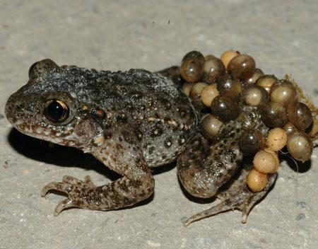
Some frogs do it too

Slide 25
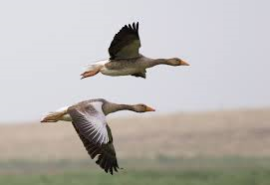
The different reproductive strategies
Monogamy - each adult mates with only one member of the opposite sex. E.g. Geese, Penguins
2. Polygamy – One male mates with more than one female or one female mates with several males, (see next two types).

Slide 26
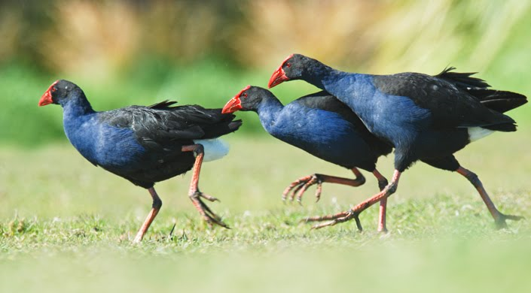
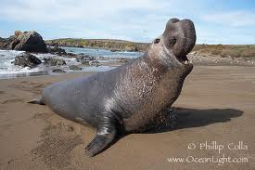
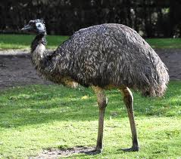
3. Polygyny a male may mate with many females. May have a ‘harem’’ E.g. sea elephants, deer (most mammals) –
4. Polyandry the mating of one female with more than one male, while each male mates with only one female. E.g. Emus.
5. Polygynandry (promiscuity) both males and females mate with more than one member of the opposite sex. E.g. Pukeko, Chimp.

Slide 27
6. Synchronized spawning all the members of the same species spawn together. E.g. corals, palolo worm, grunion.
7. Cooperative breeding Baby is fed by the parents and also by other members of the group. e.g. Mexican Jay
8. Kin Selection Genetically related animals live together. E.g. rabbits

Slide 28

9. Social insects - Queen reproduces. All the other members of the group are infertile and have set jobs. E.g. bees, wasps and termites.

